Slide 1

GO
WayPoint |
01

Slide 2

GO
Every Morning, 120 stores wait on one spreadsheet
Fresh · 80
Style · 25
Tech · 15
2 Deports · 60 vehicles, Only 16 can carry chilled
WayPoint |
01
Messages
now
Fresh misses 8 AM

Slide 3






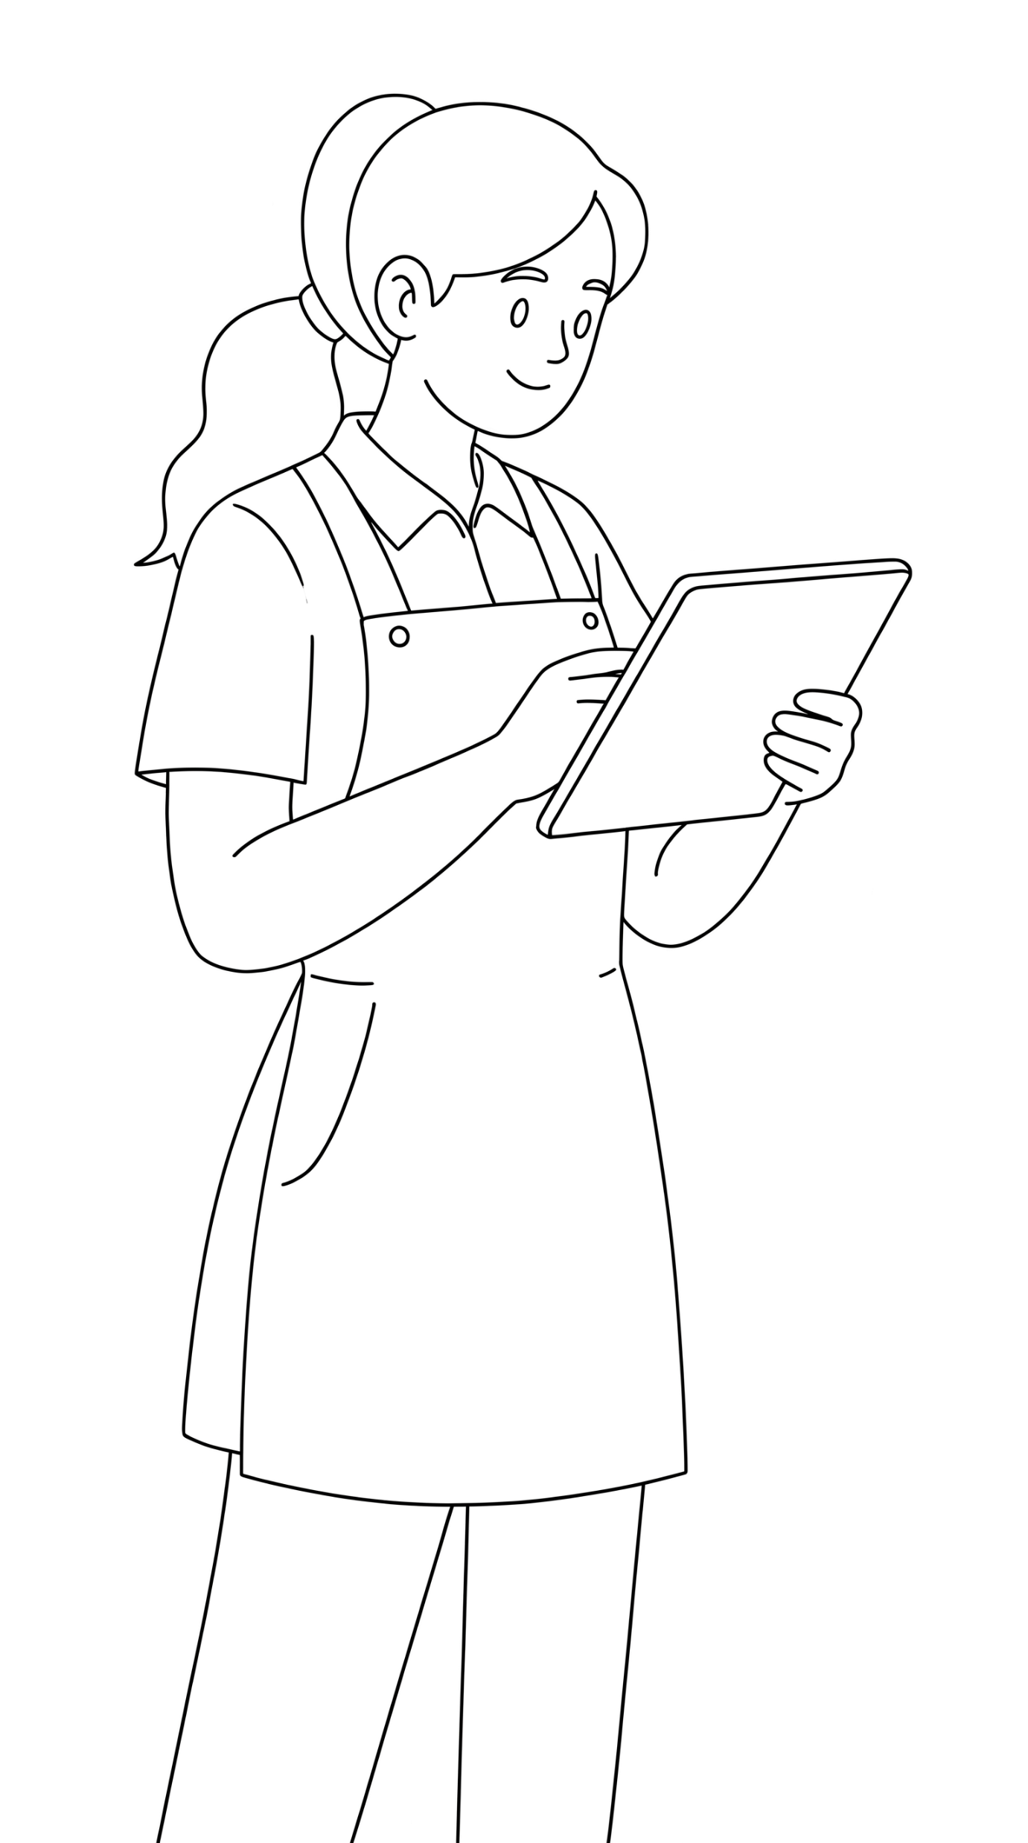
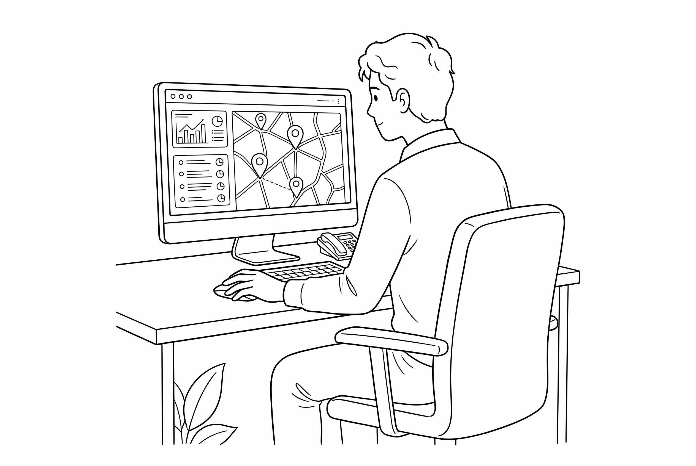
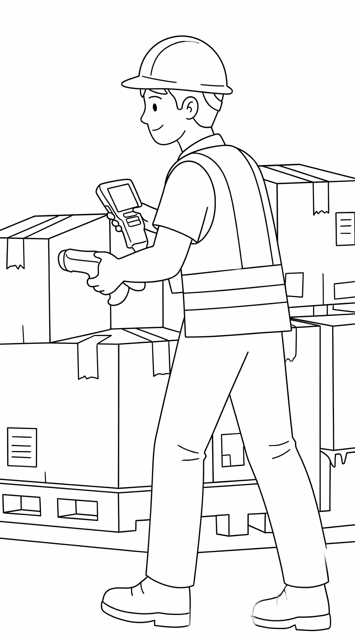
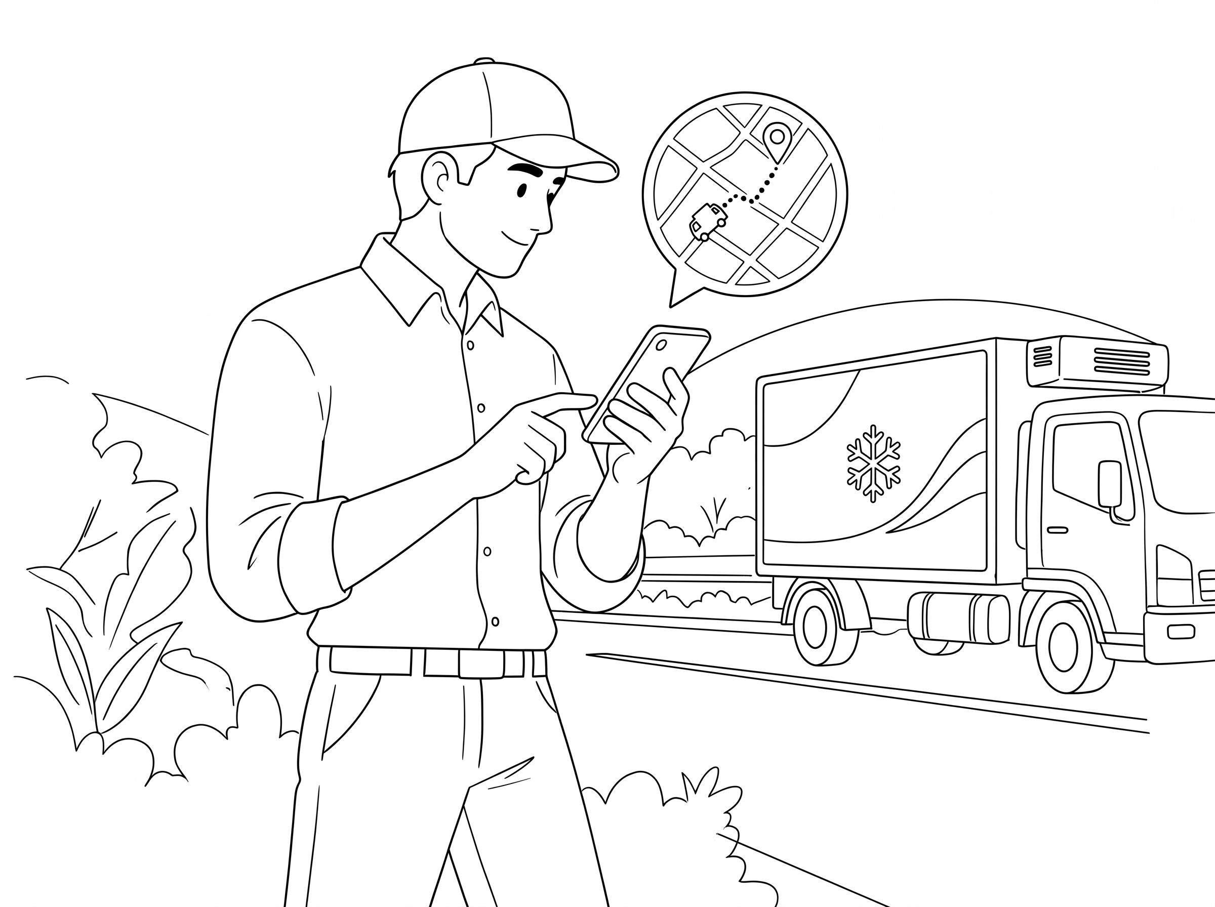
Every Morning, 120 stores wait on one spreadsheet
How a delivery runs today
Store Manager
Fresh · 80
Style · 25
Tech · 15
Phones the order in
2 Deports · 60 vehicles, Only 16 can carry chilled
Dispatcher
Types it into a spreadsheet
Messages
now
Loader
Messages
now
Works from a printed list
Fresh misses 8 AM
Driver
Messages
now
Chilled stock spoils
Paper sheet · Invisible once on the road
Disputes rest on memory
01
4 People One app,
Every Handoff on record

Slide 4

4 People One app,
Every Handoff on record

Slide 5

4 People One app,
Every Handoff on record

Slide 6
4 People One app,
Every Handoff on record
Designed for people
who start at 3 AM
Go Green
The next step to take · From our logo
Teal
Decisions and links · Calm & trusted
Night
Dark screens do for 3 AM · No glare in the cab

Slide 7



4 People One app,
Every Handoff on record
Designed for people
who start at 3 AM
Go Green
One action per screen
The next step to take · From our logo
Teal
Slide to confirm
Decisions and links · Calm & trusted
Night
Sinhala · Tamil · English
Dark screens do for 3 AM · No glare in the cab

Slide 8
Designed for people
who start at 3 AM
One action per screen
4 People One app,
Every Handoff on record
Go Green
The next step to take · From our logo
Slide to confirm
Teal
Decisions and links · Calm & trusted
Sinhala · Tamil · English
Night
Dark screens do for 3 AM · No glare in the cab
One delivery day,
One record
Delivery Record
Wed 28 Oct · VEH037
4:00 PM
Dispatcher
Plan ready in seconds · every waiting order explained
3:13 AM
Loader
Last stop loaded first · damage flagged before departure
4:00 AM
Driver
Next stop on the phone · handover saved offline
5:48 AM
Store Manager
Received and confirmed with a one-time PIN

Slide 9
Built to run, not just to demo
Four roles
One web app
One backend
Data & Models
Store manager · Phone or Desktop
Installs on phone, tablet & desktop
14 modules, one command path
Database with row-level security
Dispatcher · Desktop
Saves work offline, sends it once
Every action checked & Audited
Models for late risk & demand
Loader · Shared Tablet
සිංහල, தமிழ் & English
Live updates to every screen
Language AI · off by default, masked
Driver · Phone, even offline
Live
420
LKR 19,000
@ waypointgo.live
automated test files and specs
a month, on one server

Slide 10
Three kinds of intelligence, under one rule
Task 1
Task 2A
Task 2B + Live planner
Predict
Foresee
Decide
Which stops will be late, and how long unloading takes
Demand ten weeks ahead, as trucks, refrigerated trucks and drivers
The best plan when trucks run short, and why
Rules First
Our own models
Language AI, wording only
A person decides
If a model is ever down, GO falls back to a safe estimate and says so on screen

Slide 11
Three kinds of intelligence, under one rule
Task 1
Task 2A
Task 2B + Live planner
Predict
Foresee
Decide
Which stops will be late, and how long unloading takes
Demand ten weeks ahead, as trucks, refrigerated trucks and drivers
The best plan when trucks run short, and why
Rules First
Our own models
Language AI, wording only
A person decides
If a model is ever down, GO falls back to a safe estimate and says so on screen

Slide 12
Ground Operations
01

Slide 13

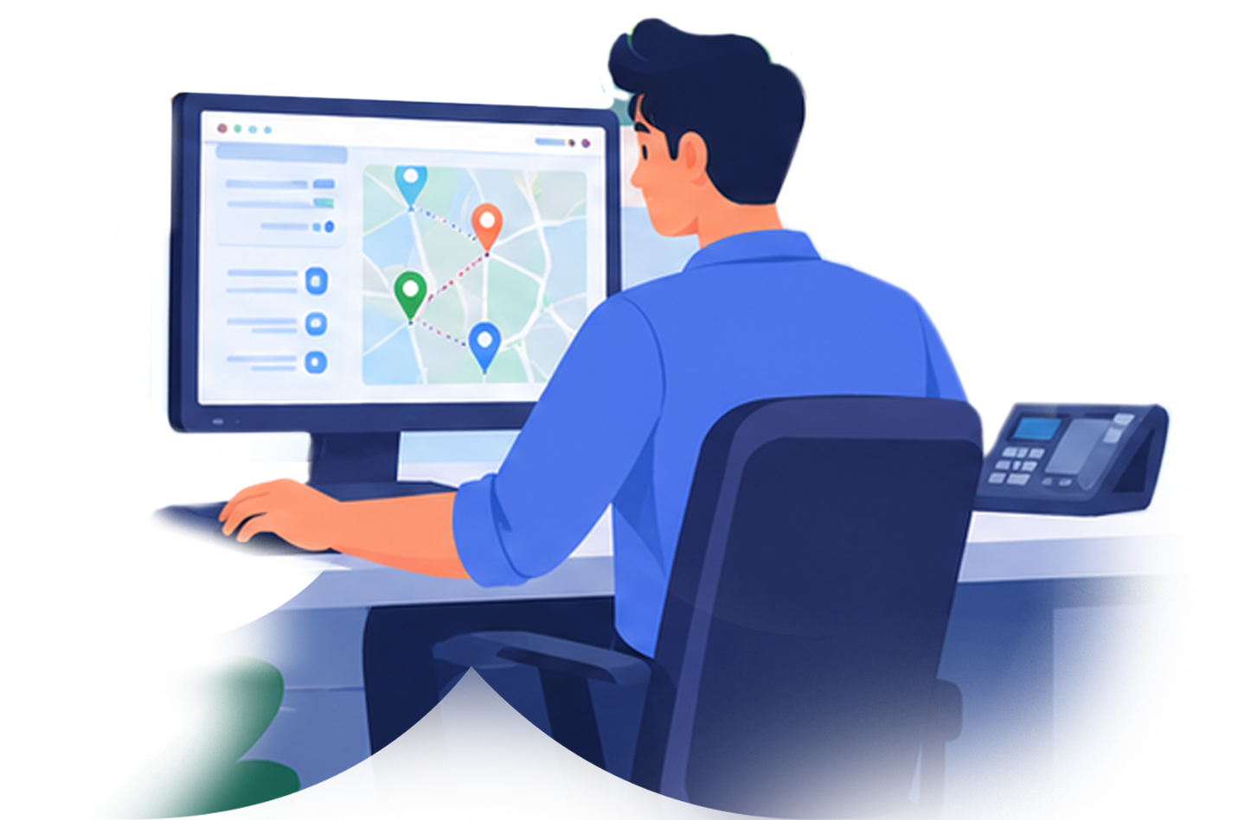

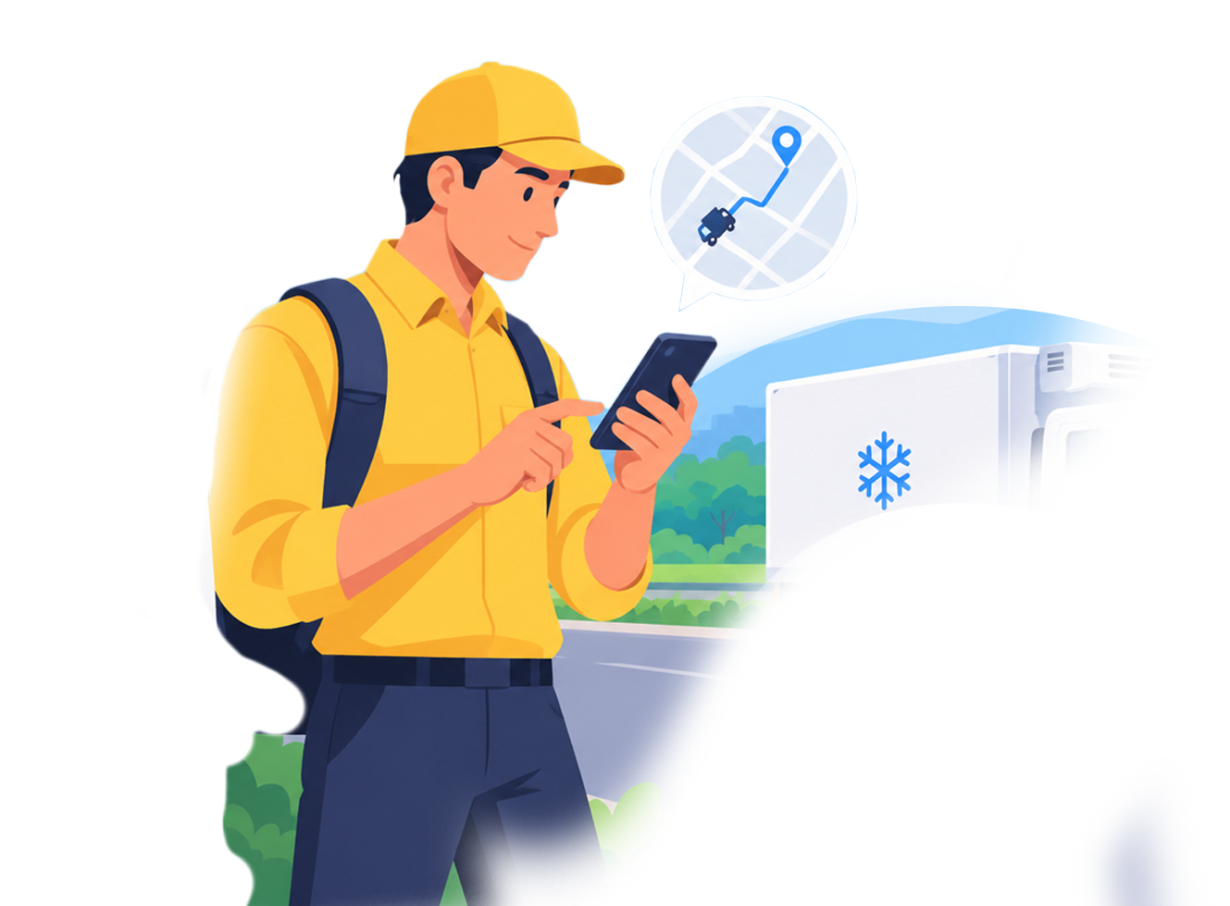
Store Manager
4 People
One app,
Every Handoff
on record
Orders & Receives
Dispatcher
Loader
Driver
01

Slide 14
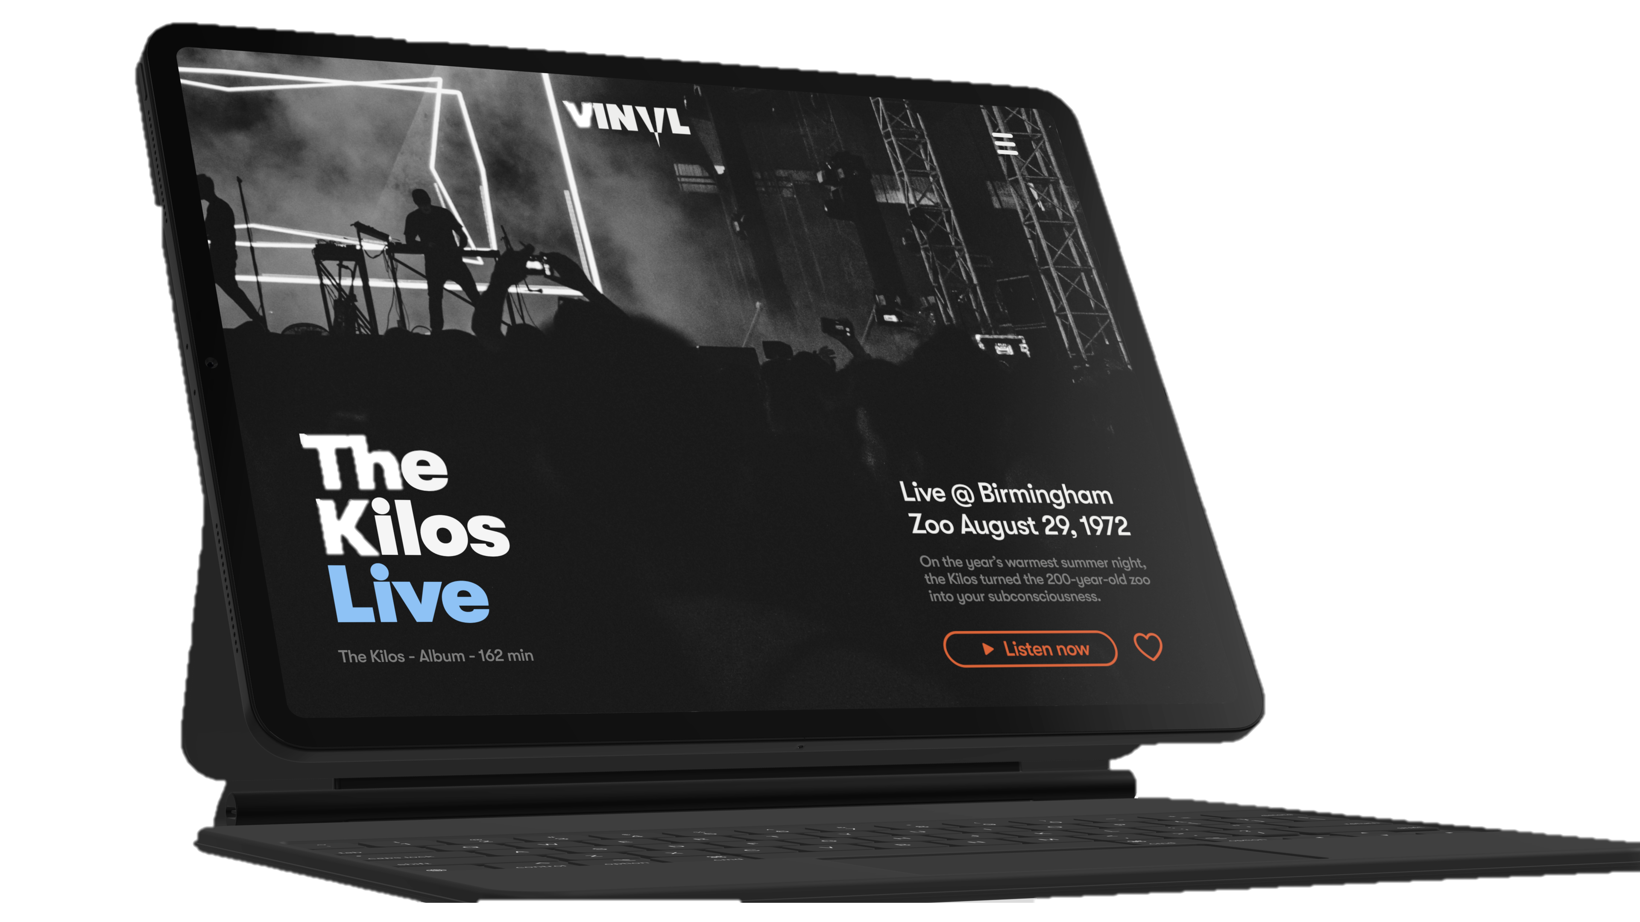

Store Manager
4 People
One app,
Every Handoff
on record
Dispatcher
Plans & Watches
Loader
Driver
01

Slide 15
Store Manager
Dispatcher
4 People · One app,
Every Handoff on record
Loader
Loades & Checks
Driver
01

Slide 16
Store Manager
4 People
One app,
Every Handoff
on record
Dispatcher
Loader
Driver
Delivers, Even Offline
01

